Slide 1
Data Service Server Roadmap
SPRING IV
Env Testing: NAS Deployment
Env Change: Change IP
Chart Discovery/Marketplace
User Manual, Training Material
SPRING III
Scaling up, One Node to Two Nodes
Software Component, v-1.2.x
Logging Management
Chart Management/Deployment
User Manual, Training Material
SPRING II
Two Node (Master + Worker), HDD 1T/5T
Software Component, v-1.1.x
Private Docker Registry
User Manual, Training Material
SPRING I
Single Node (Master), HDD 1T/5T
DeviceOn/EdgeSense Built-in
(Software Component, v-1.0.0)
User Manual, Training Material
Private Chart Repo
2019/Jul
2019/Aug
2019/Oct
2019/Dec
2020/Q1

Slide 2
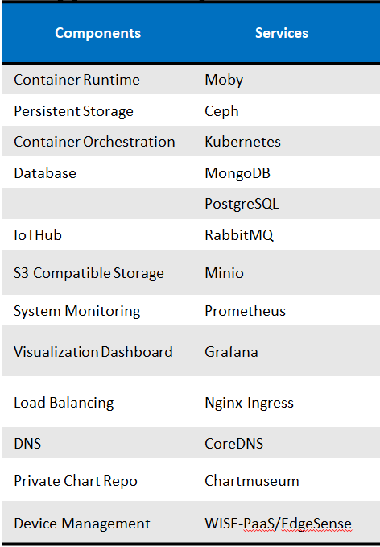
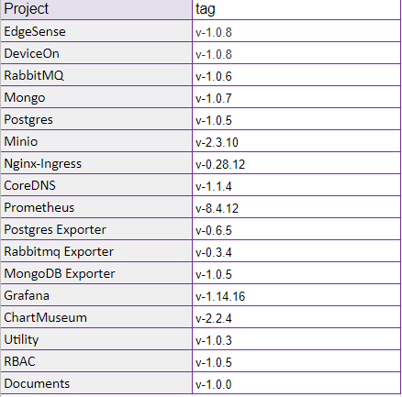
Software Component, v-1.0.0

